Slide 1

🎓 Student Report Card System in C++
By:- Isneha Varshney Jaypee University
Goal: Learning-Only Project

Slide 2
📖 Introduction
This project is a simple and effective way to store and manage student academic records using C++.
It helps in calculating student performance based on marks and displaying results efficiently.
The project improves logic-building and file-handling skills in C++.

Slide 3

🎯 Objective
Create a C++ program to manage student records Take marks input and calculate grade & percentage. Use file handling to store data permanently. Build a menu-based system to interact with users.

Slide 4

💡 Features
Add new student record Calculate percentage & grade Store data in file using binary file handling Display all student reports User-friendly menu-based interface

Slide 5

🛠️ Tools & Technologies Used
Language: C++ -IDE: Dev C++ / Code::Blocks / VS Code Concepts Used: Classes and Objects File Handling Arrays and Loops Menu-driven logic

Slide 6
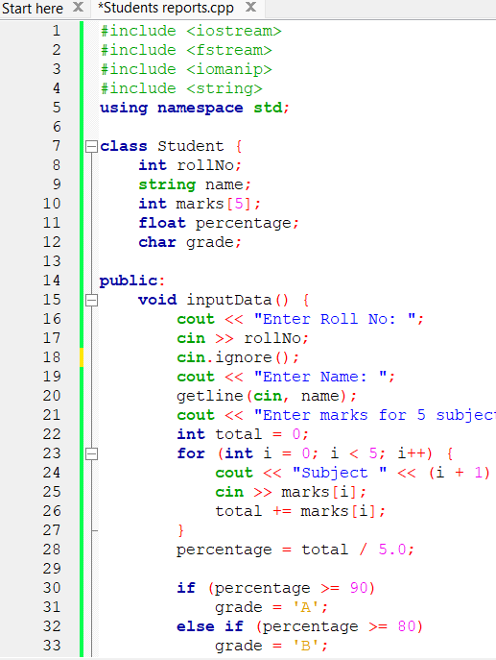
👨‍💻 Code Snippet

Slide 7
🧪 Slide 7: Sample Input (Add Student)
Enter Roll No: 101 Enter Name: Riya Sharma Enter marks for 5 subjects: Subject 1: 90 Subject 2: 85 Subject 3: 88 Subject 4: 92 Subject 5: 87 📸 [Insert Screenshot of Input Here]

Slide 8
📊 Slide 8: Sample Output (Show Student)
--- Student Report --- Roll No : 101 Name : Riya Sharma Percentage : 88.40% Grade : B ---------------------- 📸 [Insert Screenshot of Output Here]

Slide 9

🔁 How it Works (Logic Flow)
User sees menu Selects Add or Show option Enters data if adding a student
Data gets saved using file handling When "Show" is selected, all saved records are displayed

Slide 10
📊 Conclusion & Learning
Improved logic building using C++ Understood real use of OOP and files Gained confidence in writing structured programs Learned how to create a working mini-project

Slide 11
Thank you for reviewing my project! 🙏 I look forward to learning and improving further.

